Slide 1
Characterization
Crystal 5x5x50 mm eksma 2A641

Slide 2
Default values:
Experiment 05_09_17:
w0 = 49e-6
TempGrad = Const
Crystal = Crystal 5x5x50 mm eksma 2A641
Laser = Luce
offset = -0.3; % For P2w vs T
Simulation:
W0 = 49e-6
TempGrad = Const
Pump = Depleted
L = 5e-2 cm
PinAvg = 29.20e-3;
f = 10K;
Pulse_wdt = 5e-9 to 8e-9 s

Slide 3
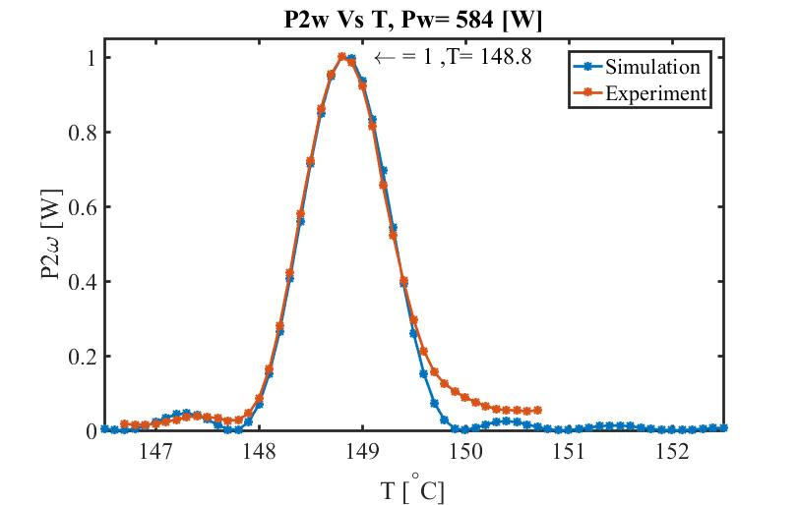
Pulse width = 5ns
Normalized comparison P2w vs T

Slide 4
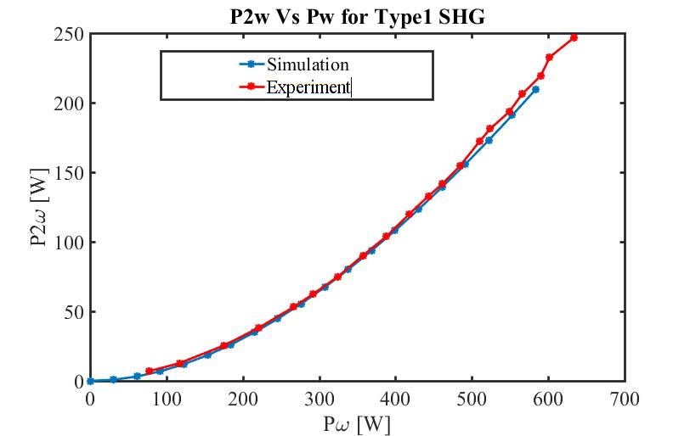
Compared results assuming transmission of 0.31032

Slide 5
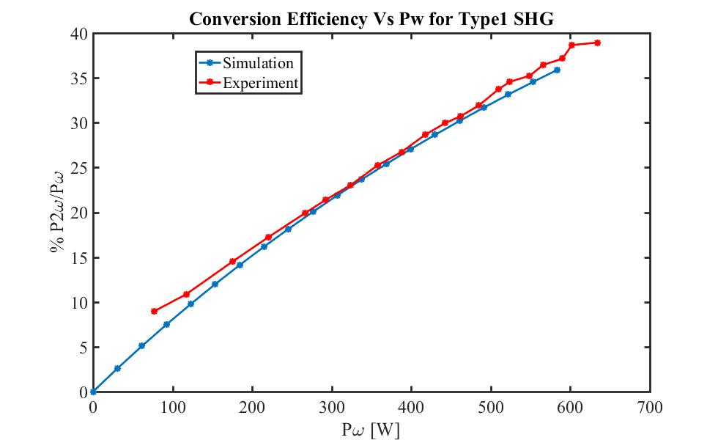
Compared results assuming transmission of 0.31032

Slide 6
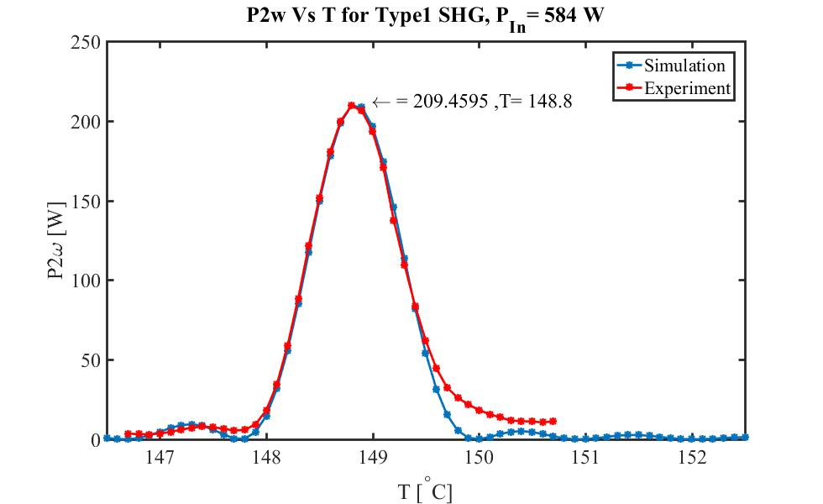
Compared results assuming transmission of 0.31032

Slide 7
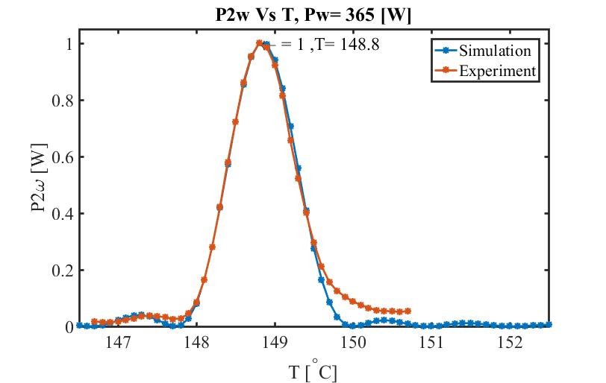
Pulse width = 8ns
Normalized comparison P2w vs T

Slide 8
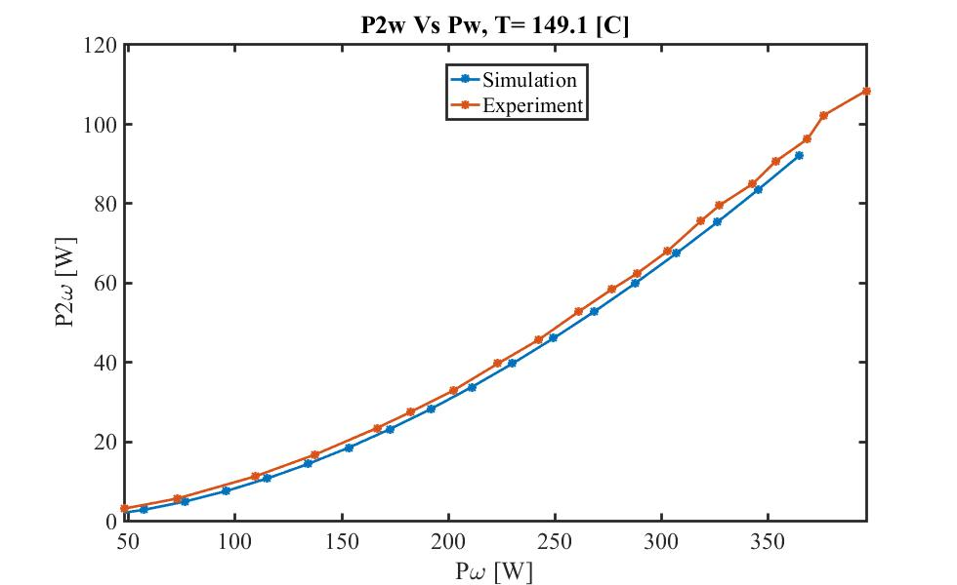
Compared results assuming transmission of 0.44241

Slide 9
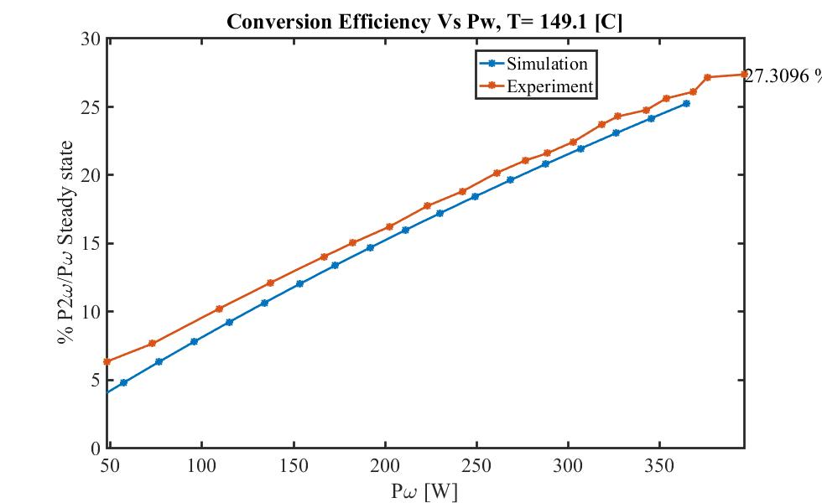
Compared results assuming transmission of 0.31032

Slide 10
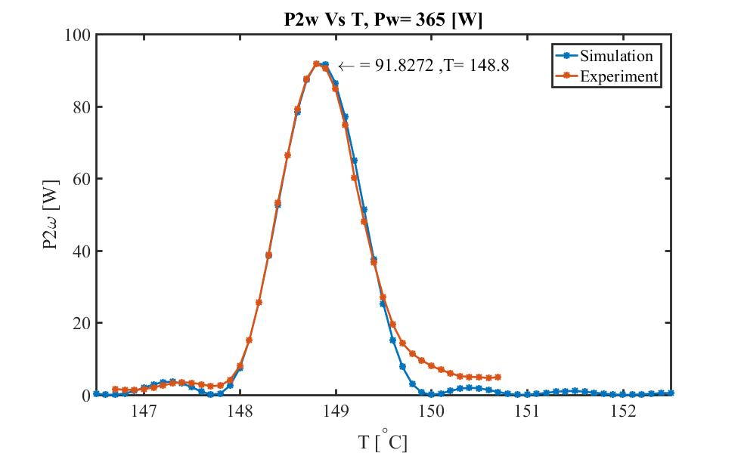
Compared results assuming transmission of 0.31032

